Slide 1

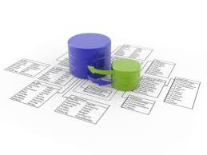


Hybrid Mobile Applications
Course Program, Evaluation, Examination
Hybrid Mobile Applications
Telerik Software Academy
http://academy.telerik.com

Slide 2

Table of Contents
The Mobile Development course program
Hybrid mobile apps course
The Trainers Team
Exams and Evaluation
Standard Criteria
Bonuses
Resources for the Course

Slide 3

Mobile Development Track
Coming To The LAST Module

Slide 4
Mobile Development Track
Brief courses on most used mobile platforms
Hybrid mobile apps with JavaScript
iOS, Android, Windows 8 and more
Android apps with Java
iOS apps with Objective-C
Windows 8 apps with C# and XAML

Slide 5
Mobile Development Track Courses
Starts on 09-Sep-2014
Web Services & Cloud Technologies
Exam on 22-Sep-2014

Slide 6
Mobile Development Track Courses
Starts on 09-Sep-2014
Web Services & Cloud Technologies
Exam on 22-Sep-2014
Hybrid Mobile Apps with Apache Cordova
Starts on 23-Sep-2014
Exam on 30-Sep-2014

Slide 7
Mobile Development Track Courses
Starts on 09-Sep-2014
Web Services & Cloud Technologies
Exam on 22-Sep-2014
Hybrid Mobile Apps with Apache Cordova
Starts on 24-Sep-2014
Exam on 30-Sep-2014
Starts on 01-Oct-2014
Exam on 14-Oct-2014
Android Applications

Slide 8
Mobile Development Track Courses
Starts on 09-Sep-2014
Web Services & Cloud Technologies
Exam on 22-Sep-2014
Hybrid Mobile Apps with Apache Cordova
Starts on 24-Sep-2014
Exam on 30-Sep-2014
Starts on 01-Oct-2014
Exam on 14-Oct-2014
Android Applications
iOS Applications
Starts on 15-Oct-2014
Exam on 28-Oct-2014

Slide 9
Mobile Development Track Courses
Starts on 09-Sep-2014
Web Services & Cloud Technologies
Exam on 22-Sep-2014
Hybrid Mobile Apps with Apache Cordova
Starts on 24-Sep-2014
Exam on 30-Sep-2014
Starts on 01-Oct-2014
Exam on 14-Oct-2014
Android Applications
iOS Applications
Starts on 15-Oct-2014
Exam on 28-Oct-2014
Starts on 29-Oct-2014
Exam on 11-Nov-2014
Windows Phone Applications

Slide 10
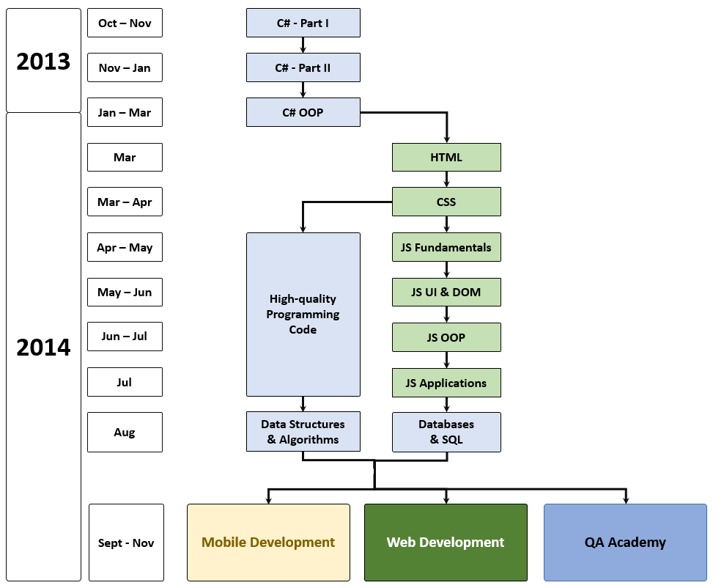
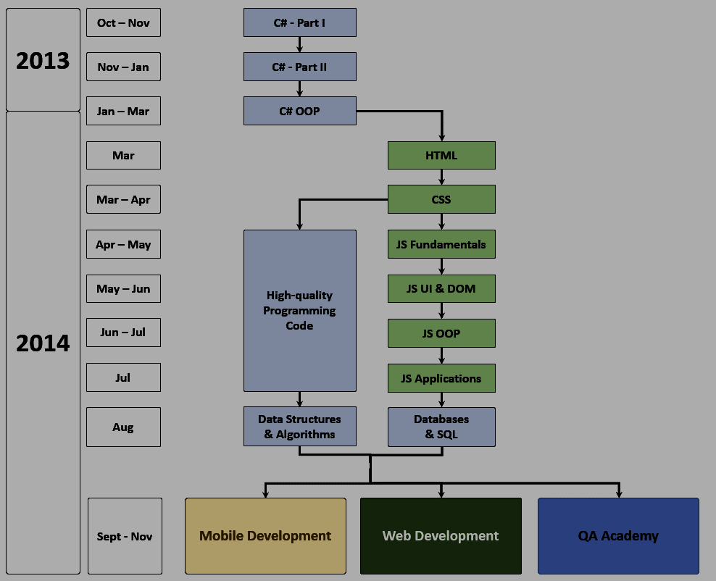
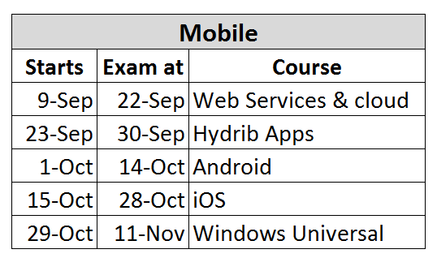
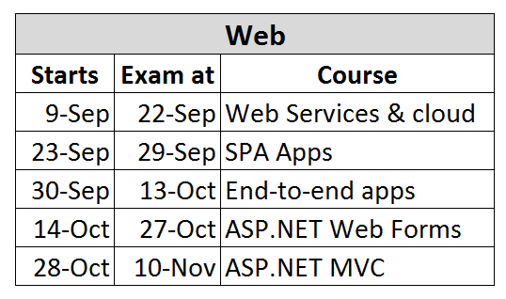
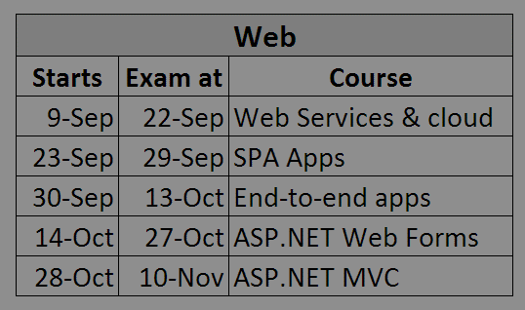
What's Coming Next?

Slide 11

Hybrid Mobile Apps: Course Program
Topics and stuff

Slide 12
The Hybrid Mobile Apps Course Program
Mobile apps
Apache Cordova introduction
Apache Cordova development tools and environment
Hybrid mobile apps with Telerik AppBuilder
Working with device APIs
Hardware and software
Phonebook, accelerometer, geolocation, etc…
Apps with KendoUI Mobile
Creating a mobile app – live demo

Slide 13

The Trainers Team

Slide 14

Trainers Team
Doncho Minkov
Senior Technical Trainer @ Telerik Software Academy
Contestant in the Informatics competitions
Experience with Web and Mobile apps
Proficient with JavaScript and .NET
Email: doncho.minkov [at] telerik.com
Blog: http://minkov.it

Slide 15

Trainers Team (2)
Evlogi Hristov
Technical Trainer @ Telerik Software Academy
Graduate from the last season of Telerik Software Academy
E-mail: evlogi.hristov [at] telerik.com

Slide 16





Evaluation
Thank God There Are Bonuses!

Slide 17


Hybrid Mobile Apps: Evaluation
Evaluation components
Course project – 75%
Homework – 10%
Homework evaluation – 5%
3 peer reviews per homework (excellent, OK, bad)
Attendance in class – 10%
Bonuses
Forums activity – bonus up to 5%

Slide 18


Pass / Excellence / Fail Criteria
Criteria for pass / pass with excellence / fail
Pass with excellence
Very high exam results
or
High total results
Pass
Average total results
Fail
Low total results or low exam results

Slide 19
Homework Peer Reviews
Everyone will get feedback for their homework
Everyone will give feedback for few random homework submissions
Students submit homework anonymously
Please exclude your name from the submissions!
For each homework submitted
Students evaluate 3 random homeworks
From the same topic, after the deadline
Homework comments are not obligatory

Slide 20
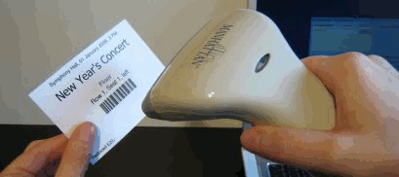
Check Your Presence
From now on you should check your presence on the barcode reader 2-3 times a day:
In the morning when lectures begin (~10:30)
After lunch break (~13:30)
When you have data structures and algorithms when the lecture starts (~18:00)

Slide 21
Course Project
The course project will consist of developing an hybrid application with Apache Cordova
In random teams of two
Should work on at least two platforms
Should work with remote data (REST)
Should use device capabilities
And more
More details later today

Slide 22








Resources
What We Need in Addition to this Course Content?

Slide 23

Course Web Site & Forums
Register for the "Telerik Academy Forums":
Discuss the course exercises with your colleagues
Find solutions for the exercises
Share source code / discuss ideas
The databases official web site:
http://forums.academy.telerik.com/mobile-development
academy.telerik.com/student-courses/software-technologies/hybrid-mobile-apps/about

Slide 24
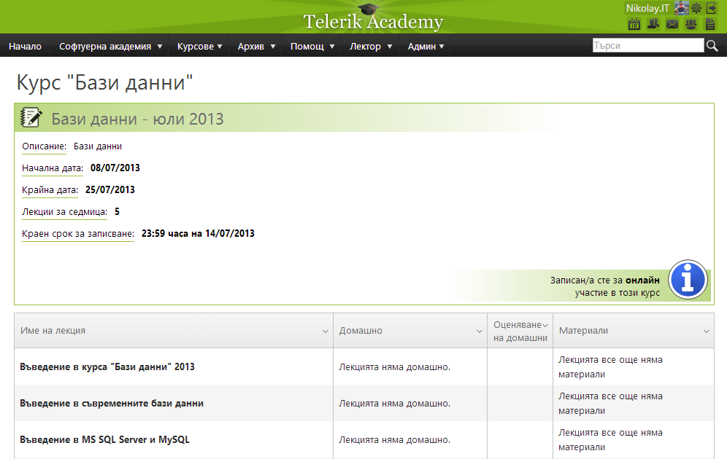
Telerik Integrated Learning System (TILS)
The Telerik Integrated Learning System (TILS)
www.telerikacademy.com
Important resource for all students
Homework submissions
Homework peer reviews
Presence cards with barcode
Reports about your results
telerikacademy.com/Courses/Courses/Details/190

Slide 25
Required Software
Software needed for this course:
Any operating system
Windows any, Linux any, MAC OSX
Any text editor will do, or IDE
Telerik App Builder, Sublime Text 2/3, VS, etc…
Mobile platforms SDKs
Android SDKs + Java dev kit
Windows phone 8 dev tools
Etc…

Slide 26





Hybrid Mobile Apps
http://academy.telerik.com

Slide 27




Free Trainings @ Telerik Academy
C# Programming @ Telerik Academy
csharpfundamentals.telerik.com
Telerik Software Academy
academy.telerik.com
Telerik Academy @ Facebook
facebook.com/TelerikAcademy
Telerik Software Academy Forums
forums.academy.telerik.com

